Slide 1

Software and Mobile Applications
Pertemuan 4
Dr. Dedi Trisnawarman

Slide 2
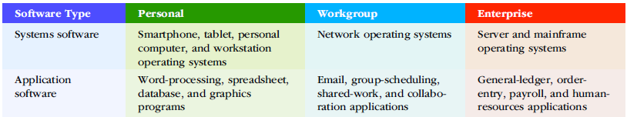
An Overview of Software
system software: Software that includes operating systems, utilities, and middleware that coordinate the activities and functions of the hardware and other programs throughout the computer system.
application software: Programs that help users solve particular computing problems.

Slide 3
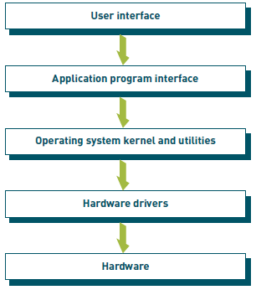
Systems Software
A set of computer programs that controls the computer hardware and acts as an interface to application software.

Slide 4
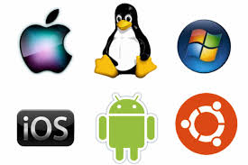
Functions Performed by the Operating System
● Control common computer hardware functions
● Provide a user interface and manage input/output management
● Provide a degree of hardware independence
● Manage system memory
● Manage processing tasks
● Provide networking capability
● Control access to system resources
● Manage files

Slide 5
User Interface
user interface: The element of the operating system that allows people to access and interact with the computer system.
command-based user interface: A user interface that requires you to give text commands to the computer to perform basic activities.
graphical user interface (GUI): An interface that displays pictures (icons) and menus that people use to send commands to the computer system.

Slide 6
Application Programming Interface (API)
application programming interface (API): A set of programming instructions and standards that enables one software program to access and use the services of another software program.
hardware independence: The ability of a software program to run on any platform, without concern for the specific underlying hardware.

Slide 7
Processing Tasks
Multiuser. Allows two or more users to run programs at the same time on the same computer. Some operating systems permit hundreds or even thousands of concurrent users. The ability of the computer to handle an increasing number of concurrent users smoothly is called scalability.
Multiprocessing. Supports running a program on more than one CPU.
Multitasking. Allows more than one program to run concurrently.
Multithreading. Allows different threads of a single program to run concurrently. A thread is a set of instructions within an application that is independent of other threads. For example, in a spreadsheet program, the thread to open the workbook is separate from the thread to sum a column of figures.
Real time. Responds to input instantly. To do this, the operating system task scheduler can stop any task at any point in its execution if it determines that another higher priority task needs to run immediately. Realtime operating systems are used to control the operation of jet engines, the deployment of air bags, and the operation of antilock braking systems—among other uses.

Slide 8
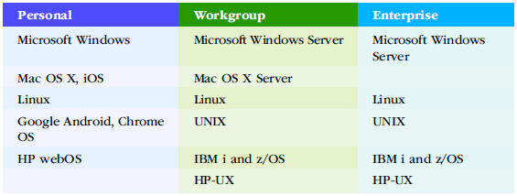
Operating Systems by Sphere of Influence

Slide 9

Linux
Linux is an OS developed in 1991 by Linus Torvalds as a student in Finland. The OS is distributed under the GNU General Public License, and its source code is freely available to everyone. It is, therefore, called an opensource operating system.

Slide 10

Red Hat Linux
Red Hat Enterprise Virtualization (RHEV) software provides virtualization capabilities for servers and desktop computers.
Source: www.redhat.com

Slide 11
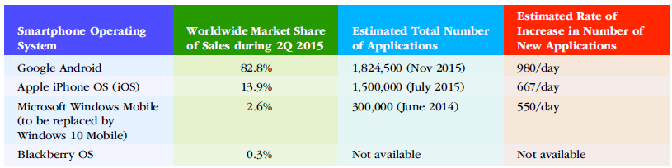
Mobile Operating Systems
Smartphones now employ full-fledged personal computer operating systems such as the Google Android, Apple iOS, and Microsoft Windows Phone that determine the functionality of your phone and the applications that you can run.

Slide 12
Embedded System
embedded system: A computer system (including some sort of processor) that is implanted in and dedicated to the control of another device.
A GPS device uses an embedded system to acquire information from satellites, display your current location on a map, and direct you to your destination.

Slide 13
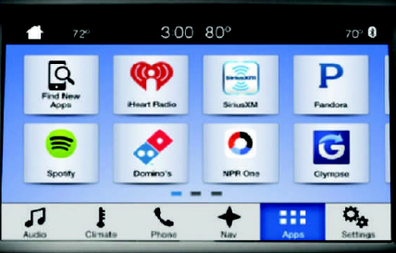
Windows Embedded
a family of Microsoft operating systems included with or embedded into small computer devices.
For example, Windows Embedded Compact includes several versions that provide computing power for TV set-top boxes, automated industrial machines, media players, medical devices, digital cameras, PDAs, GPS receivers, ATMs, gaming devices, and business devices such as cash registers.
The Ford Sync 3 system allows drivers to wirelessly connect smartphones and media devices to automotive systems.

Slide 14
Utility Program
A program that helps to perform maintenance or correct problems with a computer system.
Some of the examples of the utility programs (Utilities) include: Disk defragmenters, System Profilers, Network Managers, Application Launchers, Antivirus software, Backup software, Disk repair, Disk Cleaners, Registry Cleaners, Disk Space analyzer, file manager, File Compression, Data Security and many more.

Slide 15
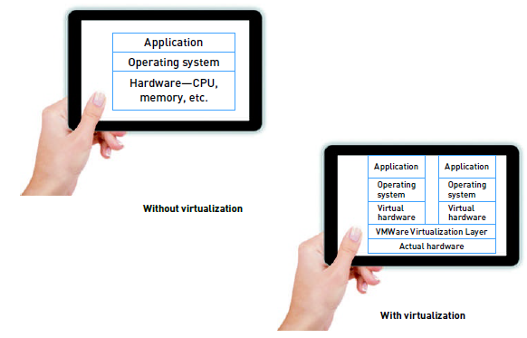
Virtualization
Virtual servers that separate a physical computing device into one or more “virtual” servers, each of which can be easily used and managed to perform computing tasks.
a virtual machine is an emulation of a computer system. Virtual machines are based on computer architectures and provide functionality of a physical computer.

Slide 16
Middleware
middleware: Software that allows various systems to communicate and exchange data.
enterprise application integration (EAI): The systematic tying together of disparate applications so that they can communicate.
service-oriented architecture (SOA): A software design approach based on the use of discrete pieces of software (modules) to provide specific functions as services to other applications.

Slide 17
Overview of Application Software
proprietary software: Oneof- a-kind software designed for a specific application and owned by the company, organization, or person that uses it.
off-the-shelf software: Software produced by software vendors to address needs that are common across businesses, organizations, or individuals.
Software as a Service (SaaS): A service that allows businesses to subscribe to Web-delivered application software.
Tableau is available in desktop and cloud versions and helps users visualize data, such as how the unemployment rate changes over a 20-year period.
software suite: A collection of programs packaged together and sold in a bundle. Microsoft Office 365 is a Web-based application suite that offers basic software suite features over the Internet using cloud computing.

Slide 18
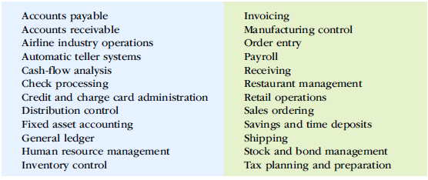
Enterprise Application Software

Slide 19
Programming Languages
Sets of keywords, commands, symbols, and rules for constructing statements by which humans can communicate instructions to a computer.
syntax: A set of rules associated with a programming language.
compiler: A special software program that converts the programmer’s source code into the machine-language instructions, which consist of binary digits.

Slide 20
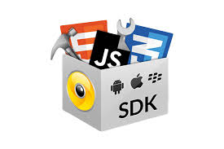
IDE-SDKs
An integrated development environment (IDE) is a software application that provides comprehensive facilities to computer programmers for software development. An IDE normally consists of at least a source code editor, build automation tools and a debugger.
A software development kit is a collection of software development tools in one installable package. They ease creation of applications by having compiler, debugger and perhaps a software framework. They are normally specific to a hardware platform and operating system combination

Slide 21
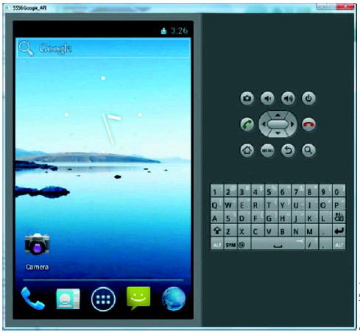
Emulator
Emulator for Android smartphones To develop for the Android, you use an SDK with a mobile device emulator so you can prototype, develop, and test Android applications without having to transfer them to a physical device.

Slide 22
Software Bugs
A software bug is a defect in a computer program that keeps it from performing as its users expect it to perform. While some bugs are subtle—allowing errors to creep into your work undetected—other bugs are very obvious, causing programs to terminate unexpectedly.

